Slide 1
Arabic Text Summarization

Slide 2
Supervisors:
Dr. Mohamed Mabrouk
TA. Youmna Ahmed

Slide 3
Team Member:
Aya Ashraf Mostafa Selim
Omnia Ayman Mohamed
Engy Assem Ahmed
Lujain Ahmed Elsayed
Ahmed Mohamed Elsayed

Slide 4
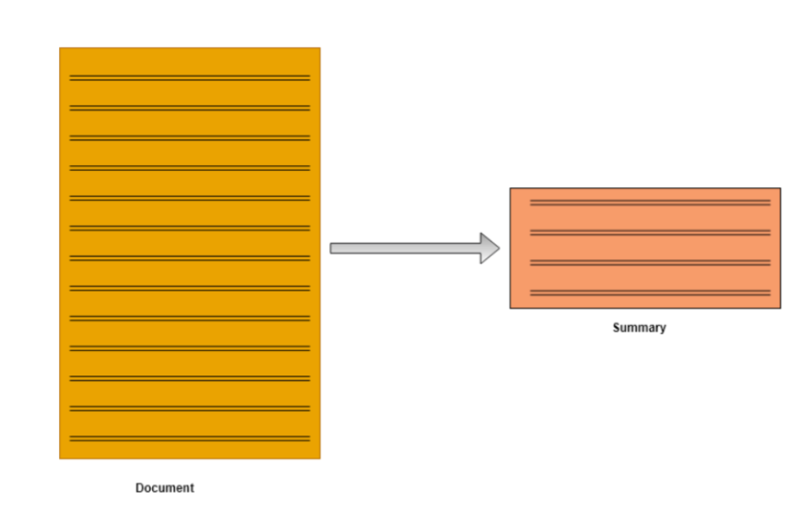
Introduction
Automatic text Summarization process.
Text summarization in NLP field.
The increase in the numbers of the Arabic webpages.

Slide 5
Problem Definition
Lack of Arabic language libraries.
Arabic language has a complex morphological structure.
Arabic makes morphological analysis such as stemming a very complex task.
There are many pieces of Research in NLP for Latin languages compared to the Arabic language, especially in the summarization field.

Slide 6
Motivation
There are more than 350 million Arabic speakers in the world.
The massive increase of online documents.
Saving time.
Not much work has been done for Arabic summarization.

Slide 7
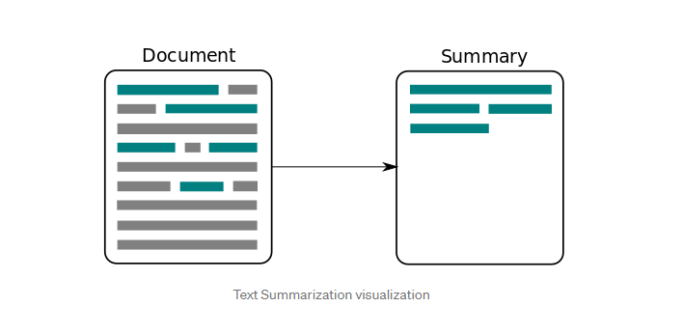
Objective
Create application for Arabic text summarization which will:
Generate short text.
Present the most important content.
Extract Title from the original text.

Slide 8
System Architecture
Document
Building graph
Applying Modified PageRank
Summary extraction
Evaluate Performance
Preprocessing
Features extraction
Applying AKEA
Algorithm
Summary
Text Title

Slide 9
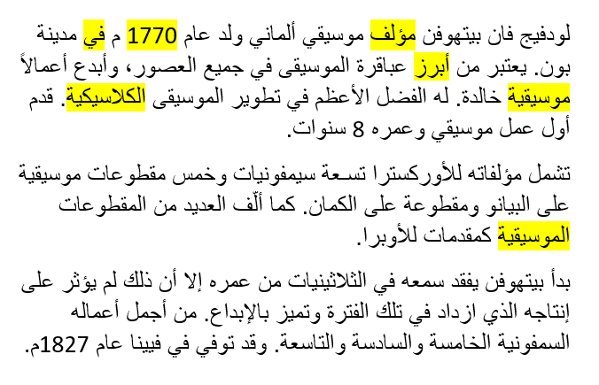
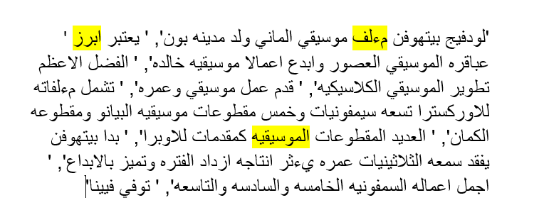
Phases Description
1. Preprocessing:
Normalization
Tokenization
Removing stop words

Slide 10
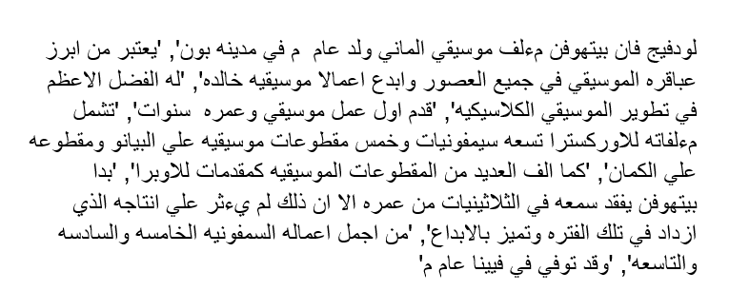
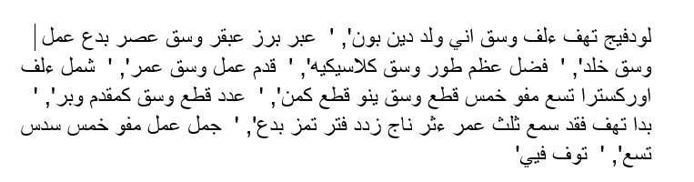
Phases Description
2. Stemming:
Using ISRI Stemmer
Remove possible prefix
Map remaining words to a group of patterns.
Search for possible matches within group of patterns
Remove suffix
Return stem

Slide 11
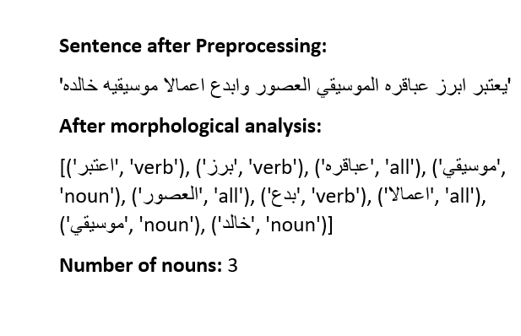
Phases Description
3. Morphological analysis:
Using qalsadi :

Slide 12
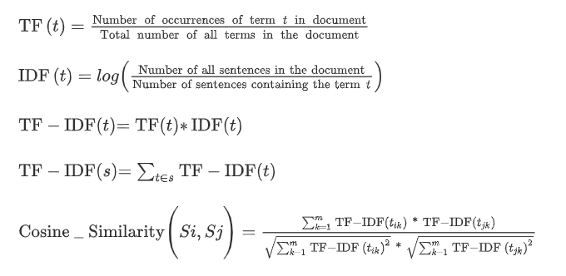
Phases Description
4. Features extraction and building a graph
TF-IDF Vectorizer

Slide 13
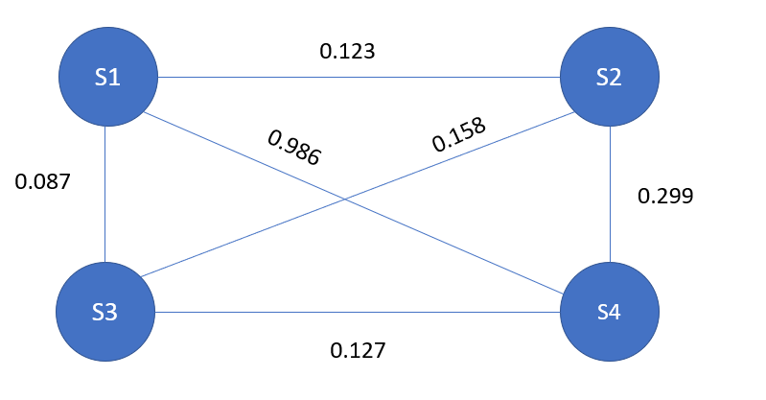
Phases Description
4. Features extraction and building a graph
B. Cosine Similarity

Slide 14
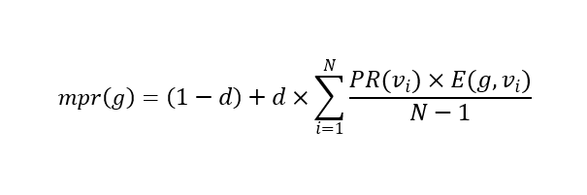
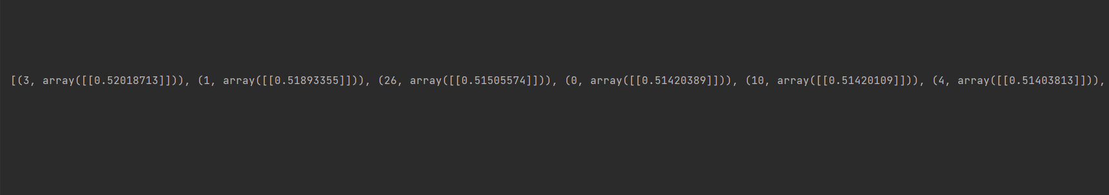
Phases Description
5. Modified Page Rank Algorithm

Slide 15
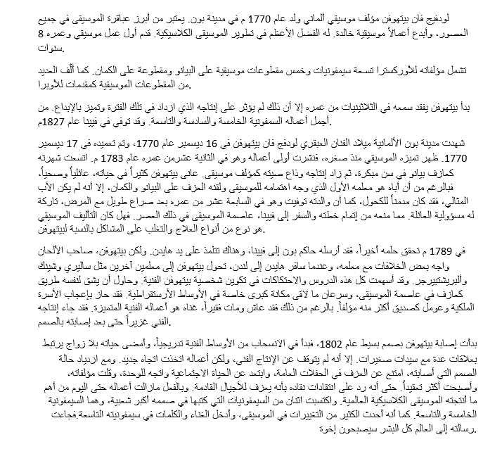
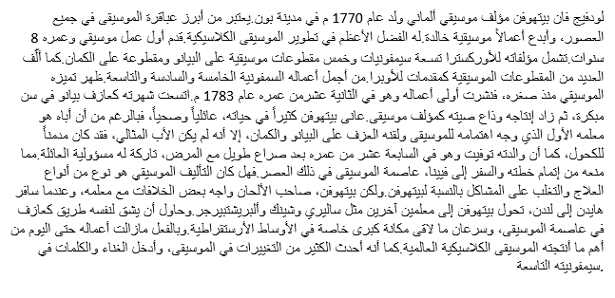
Phases Description
6. Summery extraction

Slide 16
Dataset
The Essex Arabic Summaries Corpus (EASC) It consists of 153 documents.
Each document has five corresponding summaries written by human experts.

Slide 17
Phases Description
7. Summery Evaluation

Slide 18

Phases Description
8. Extract Title

Slide 19
Experimental Results
Using ISRI Stemmer instead of Khoja Stemmer:
Improve time

Slide 20
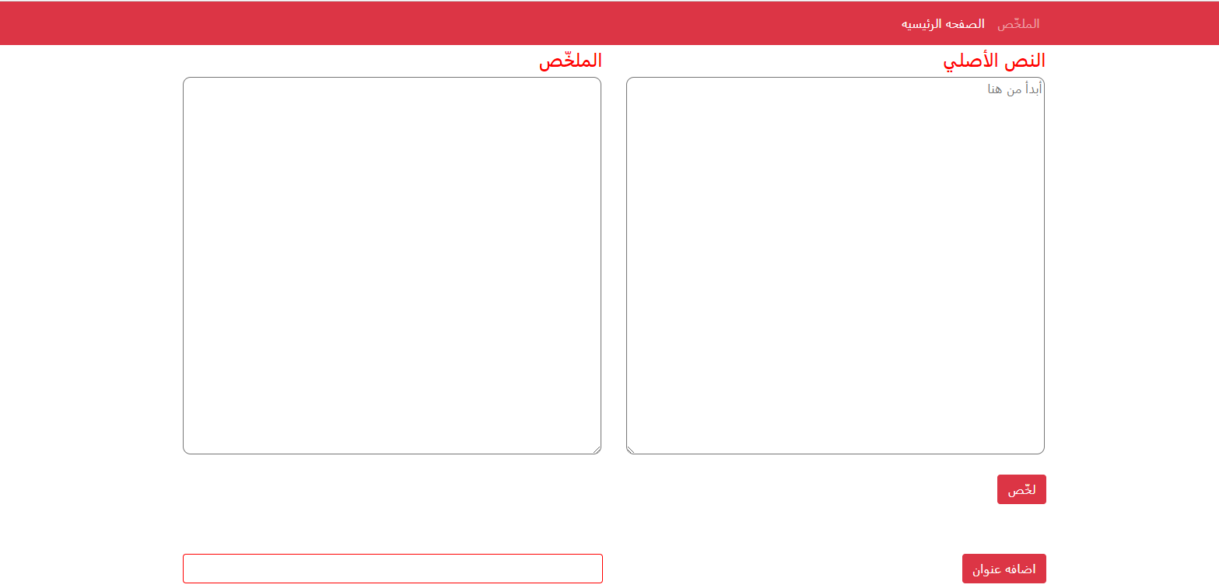
Website Tools
HTML
CSS
Bootstrap
Flask

Slide 21
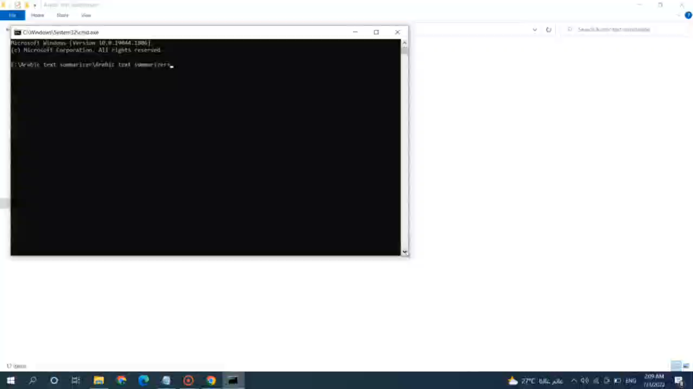
Demo

Slide 22
Conclusion and Future Work
Conclusion
The Arabic language is considered one of the strongest and most difficult languages.
Our system saves time for Arabic users and make it easier for them to summary any Arabic text.
A Modified PageRank algorithm was used to extract the summary.
Page Rank algorithm returns better results than the methods created before it.

Slide 23
Conclusion and Future Work
Future Work
Summarize the videos and audio recordings.
Translate the summary text to any other language.
Add a voice to the system to read the summary text.

Slide 24
References
[1] Hani Alghanem , Rashan H Ajamiah .(December 2020). Arabic text summarization approaches: A comparison study
[2] Lamees MahmoudAl Qassem , DiWang , ZaidAl Mahmoud, HassanBarada, AhmadAl-Rubaie, Nawaf I.Almoosa. (5 November 2017.). Automatic Arabic summarization: A survey of methodologies and systems
[3] Reda Elbarougya, Gamal Beherya, Akram El Khatibb.( July 2020). Extractive Arabic Text Summarization Using Modified PageRank Algorithm.
[4] Qasem A. Al-Radaideh , Dareen Q. Bataineh, (March 2018). A Hybrid Approach for Arabic Text Summarization Using Domain Knowledge and Genetic Algorithms.
[5] Said Desouki , Molham Al-Maleh,( December 2020). Arabic text summarization using deep learning approach.
[6]Hassan M.Najadat,Ismail I.Hmeidi,Mohammed N.AL-Kabi,Maysa Mahmoud Bany Issa,(Febraury 2016).Automatic KeyPhrase Extractor from Arabic Documents.
[7]Aqil Azmi, Nouf I. Altmami,( November 2018). An abstractive Arabic text summarizer with user-controlled granularity.

Slide 25
THANKS!

